Slide 1
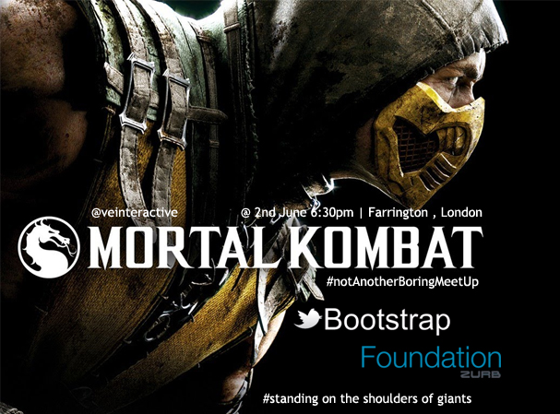

Slide 2
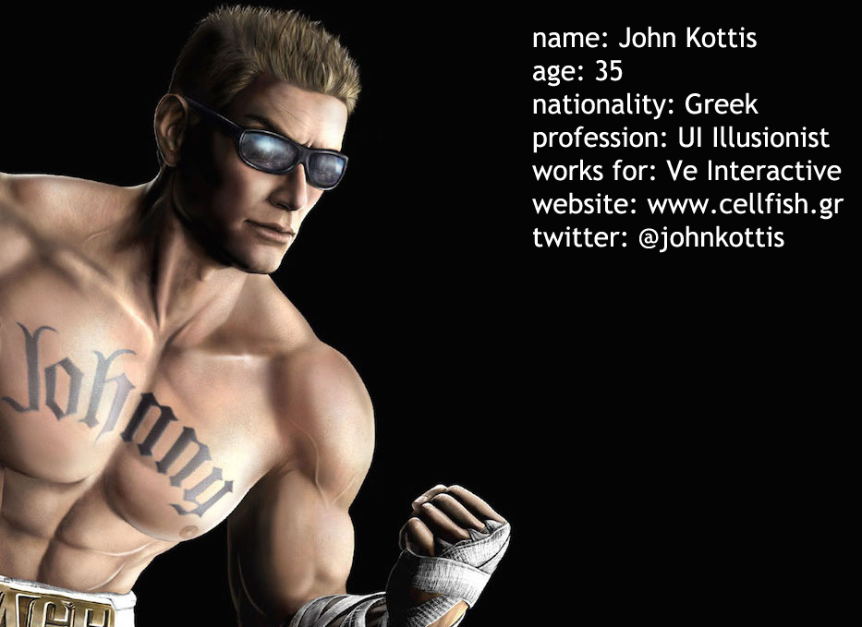

Slide 3
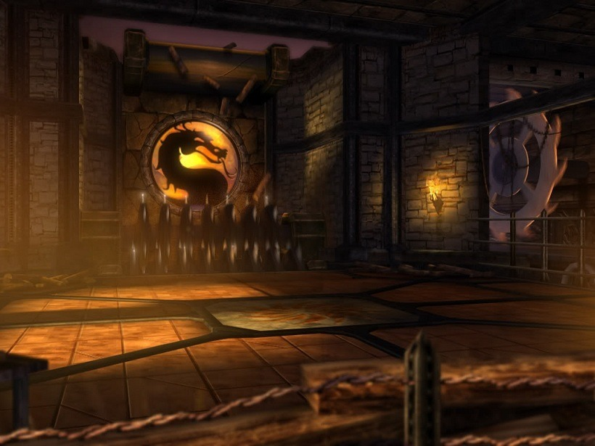
Front End Frameworks

Slide 4
Front End Frameworks
Pros
COns
Frameworks make your job easier and allow you to create standard websites with minimum effort.
Quick and easy (you don’t have to be a coder)
Tested
Plug & play functionality
Community support
Updates (Boom it’s fixed)
Unfortunately frameworks also come with some massive disadvantages.
Invest time to learn your code
Customization
Know your code
Collaboration
Updates (no control of your code)

Slide 5
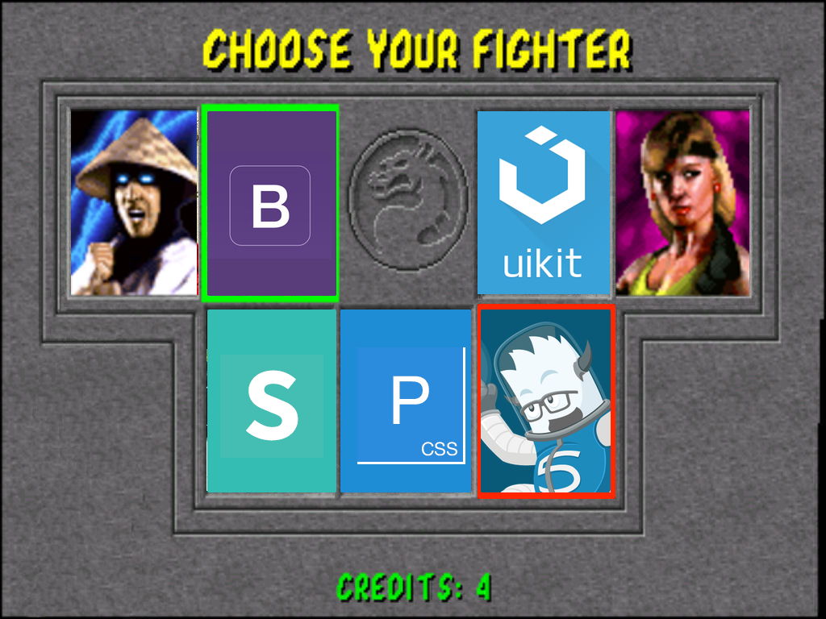

Slide 6
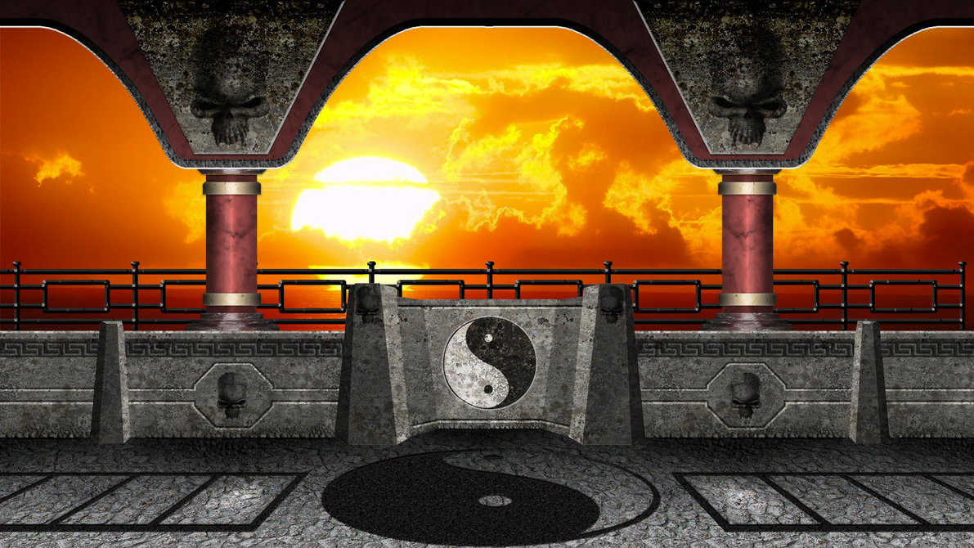
Round 1
Who & when

Slide 7
Origin stories
Twitter Bootstrap
Zurb Foundation
Bootstrap, originally named Twitter Blueprint, was developed by Mark Otto and Jacob Thornton at Twitter as a framework to encourage consistency across internal tools
Open source project under MIT license
Released in August 2011
Current version 4.0.0-alpha.2 released in December 8, 2015
Developed by Zurb (privately held interaction design company based in USA, founded in 1998)
Open source project under MIT license
Released in October 2011
Foundation for Email was released in September 2013
Foundation for Apps was released in December 2014
Current version 6.2.3 – Europa Minor

Slide 8
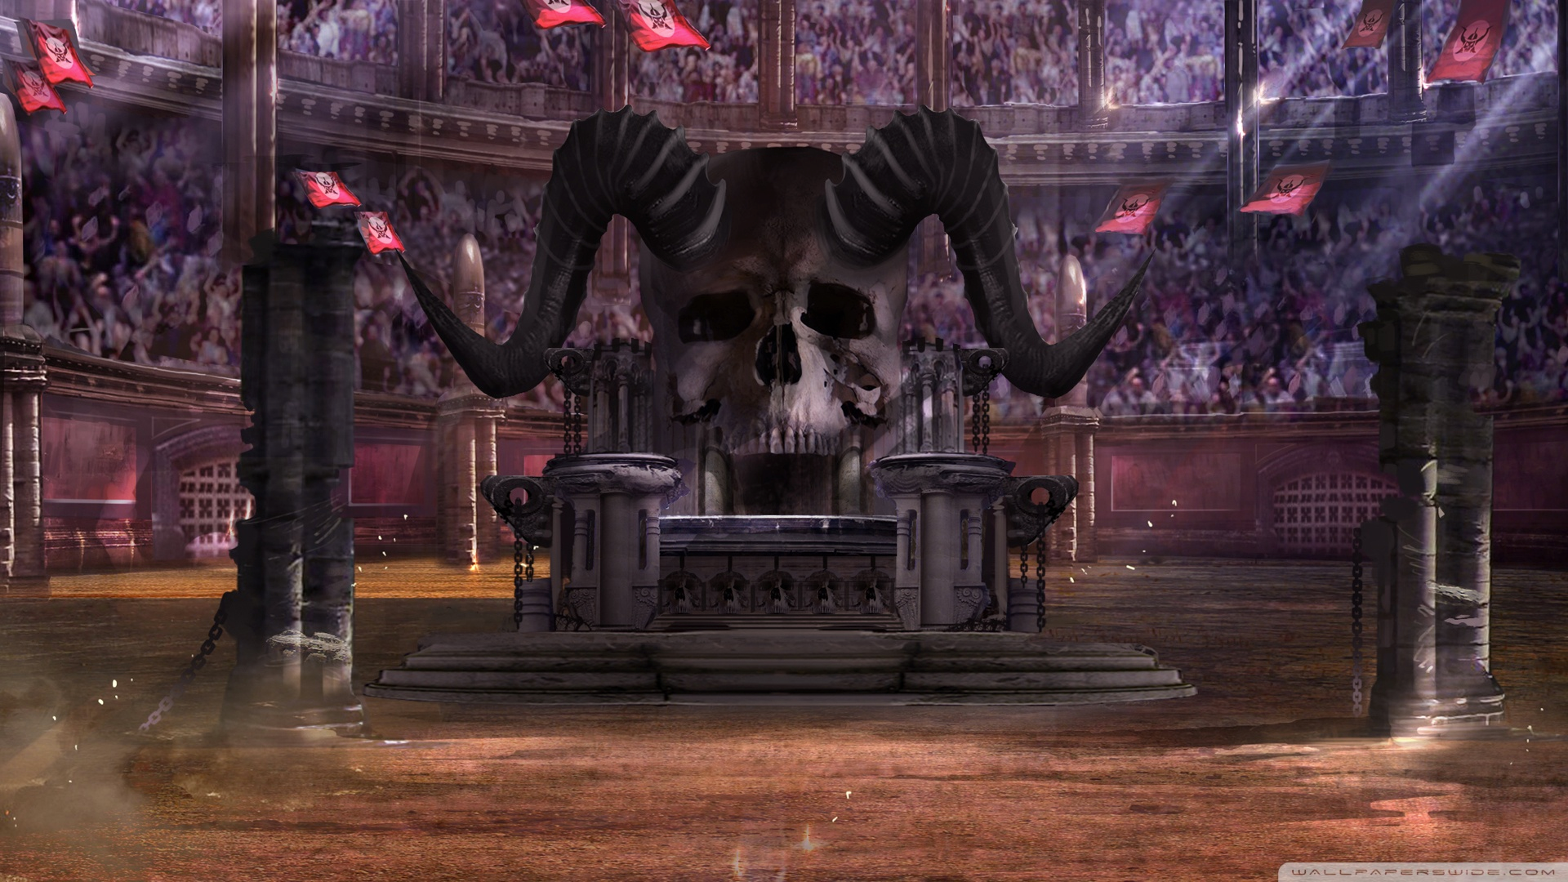
Round 2
Community & Support

Slide 9



Community & Support
Twitter Bootstrap
Zurb Foundation
97.000+ stars |  | 23.000+ stars
140.000+ results |  | 52.000+ results
N/A |  | Zurb or Certified Foundation Developers

Slide 10
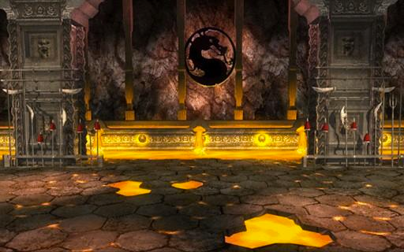
Round 3
Stylesheets

Slide 11


Stylesheets
Twitter Bootstrap
Zurb Foundation
Dropped Less in Favour of Sass (v4)
Moved from px to rem and em units (v4)
New reset called reboot (combination of normalize.css and bootstrap base styles) (v4)
CSS size : 143 KB (v3) & 120 KB (v4)
Sass
Fewer styles to override (v6)
em & rem support
Visibility classes for landscape, portrait, accessibility (screen readers) and touch devices.
normalize.css
unCSS
CSS size : 87 KB

Slide 12
Stylesheets
Twitter Bootstrap
Zurb Foundation
Viewport-based:
.hidden-xs-down
.hidden-sm-down
.hidden-md-down
.hidden-lg-down
.hidden-xl-down
.hidden-xs-up
.hidden-sm-up
.hidden-md-up
.hidden-lg-up
.hidden-xl-up
Print-based:
.visible-print-block
.visible-print-inline
.visible-print-inline-block
.hidden-print
Screen Size:
.show-for-medium
.show-for-[custom]
.show-for-medium-only
.show-for-[custom]-only
.hide-for-medium
.hide-for-[custom]
.hide-for-medium-only
.hide-for-[custom]-only
Generic (CAUTION: hides from screenreaders):
.hide (display: none;)
.invisible (visibility: hidden;)
Orientation:
.show-for-landscape
.show-for-portrait
.hide-for-landscape
.hide-for-portrait
Accessibility:
.show-for-sr (hides visually only)
.show-on-focus (for skip-links and such)

Slide 13

Round 4
Grid & Responsiveness

Slide 14
Grid & Responsiveness
Twitter Bootstrap
Zurb Foundation
12 Columns
Opt-in flexbox support
Nested Columns
Offset Columns
Ordering syntax
Offset column syntax
Media Queries syntax
1 - infinity columns (12 default)
Flexbox grid support
Nested Columns
Offset columns
Ordering syntax
Custom breakpoints
Media Queries Syntax
Gutter-free row syntax

Slide 15
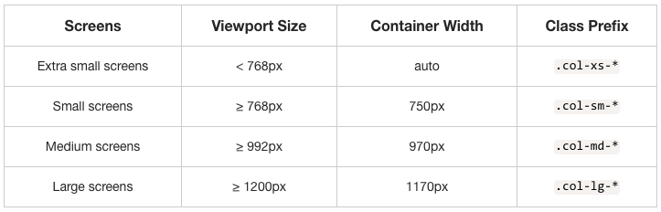
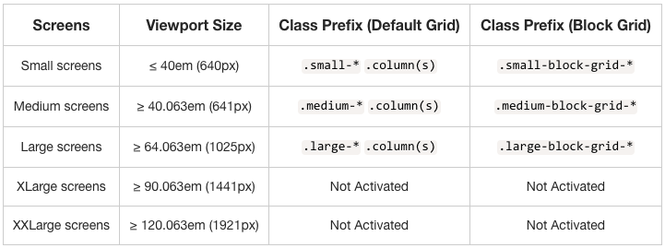
bootstrap
foundation

Slide 16
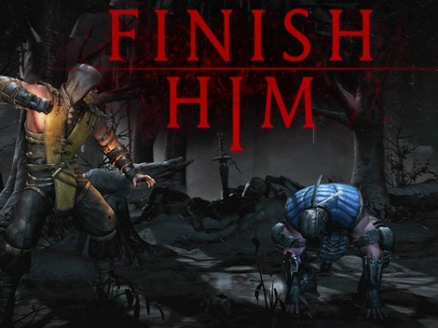

Slide 17

Interchange
Zurb Foundation
Interchange uses media queries to dynamically load responsive content that is appropriate for the user's device.
Images
HTML
Background Images
Named Media Queries
Plugin Options

Slide 18
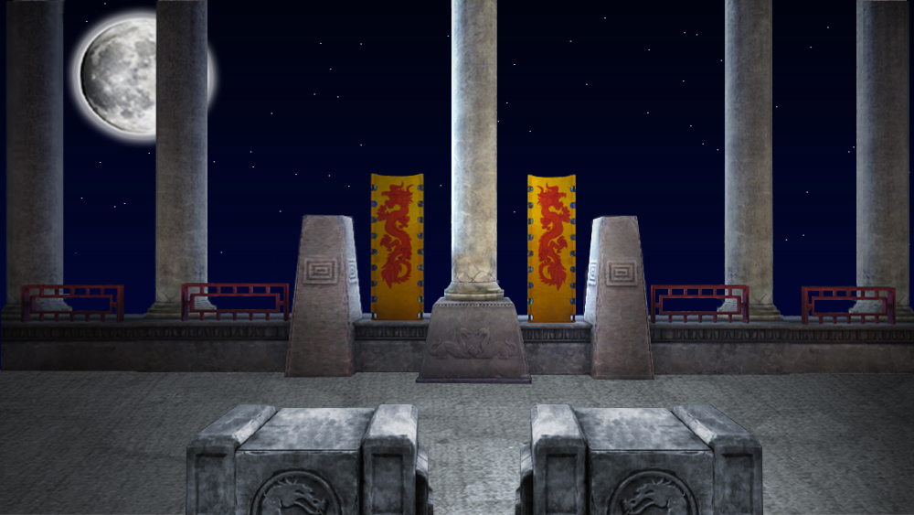
Round 5
UI & Widgets

Slide 19
UI & Widgets
Twitter Bootstrap
Zurb Foundation
Form Validation
Scrollspy
Print Styles
Media Object
Form Validation with Abide
Scrollspy with Magellan
Print Styles
Media Object
Orbit is back!
Icons (require downloading)
Right to left support

Slide 20
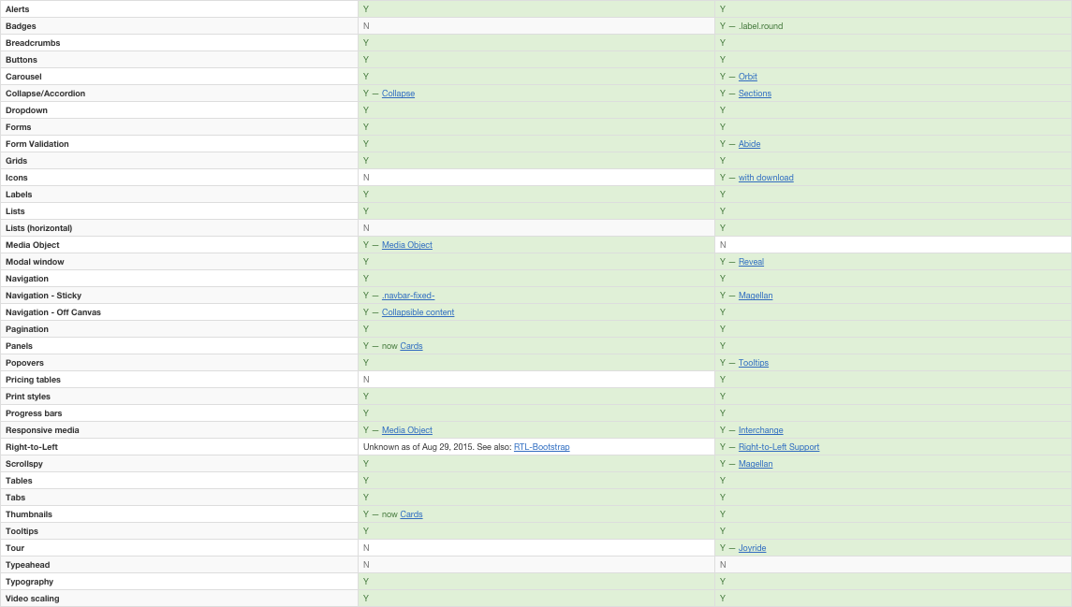
bootstrap
foundation

Slide 21
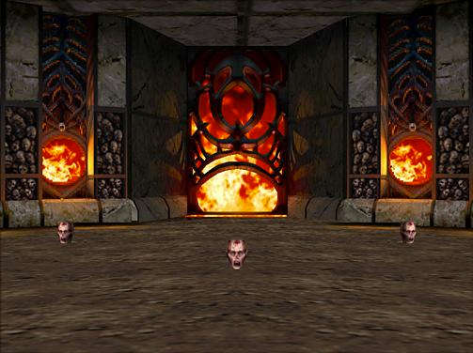
Round 6
JS Frameworks & Libraries

Slide 22


JS Frameworks & Libraries
Twitter Bootstrap
Zurb Foundation
All JavaScript plugins rewritten in ES6 (v4)
All JavaScript plugins rewritten from scratch

Slide 23
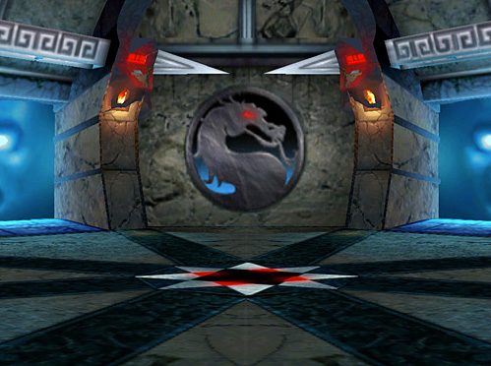
Round 7
Browser Compatibility

Slide 24
JS Frameworks & Libraries
Twitter Bootstrap
Zurb Foundation
Mobile:
Chrome - Android & iOS
Firefox - Android
Safari - iOS
Android Browser & Webview - Android
Desktop:
Chrome - Mac/ Windows
Firefox - Mac/ Windows
IE9+ - Windows
IE8 (v3)
Opera - Mac/ Windows
Safari - Mac
Last 2 Versions of:
Chrome
Firefox
Safari
Opera
Mobile Safari
IE Mobile
IE9+
Android Browser 2.3+

Slide 25
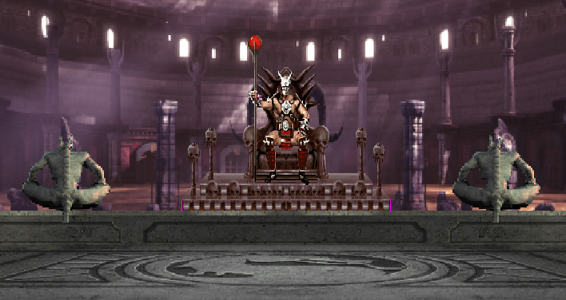
Round 8
Apps & Newsletters

Slide 26
JS Frameworks & Libraries
Zurb Foundation
Foundation for Apps
React
Meteor
Zurb Ink
Newsletters

Slide 27
Round 9
Showcase

Slide 28
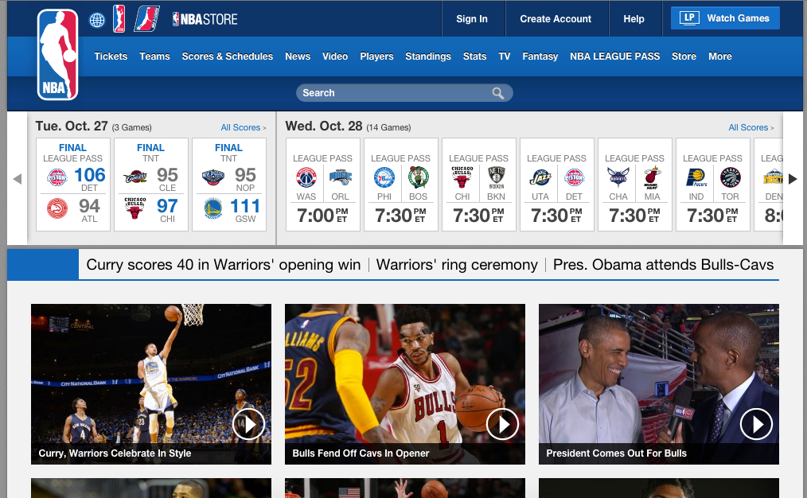
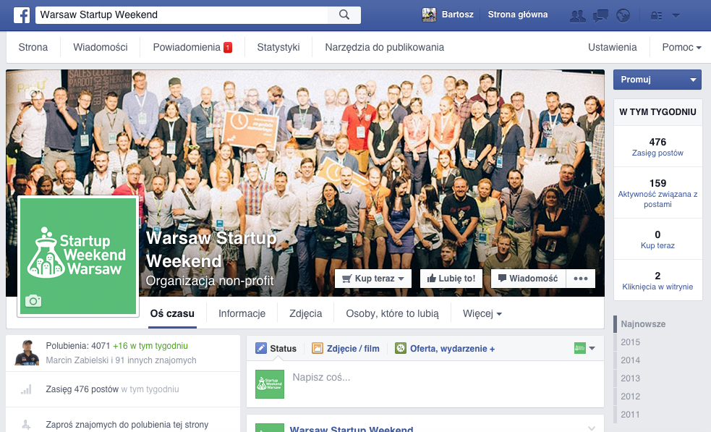
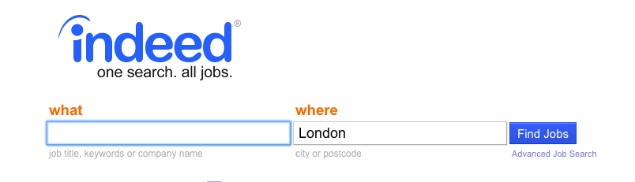

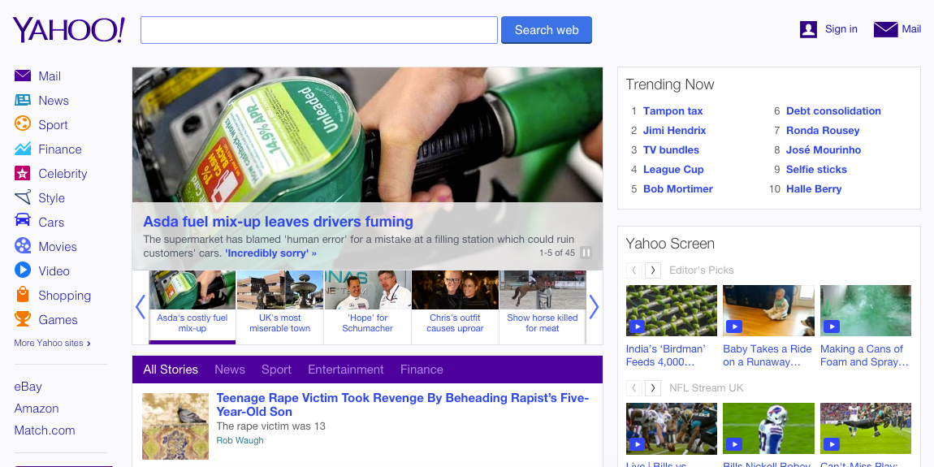
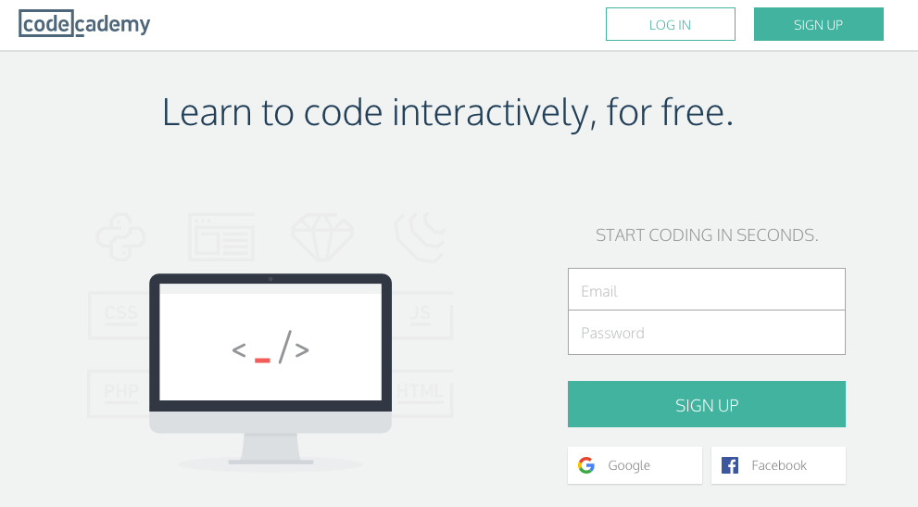

Showcase
Twitter Bootstrap
Zurb Foundation

Slide 29
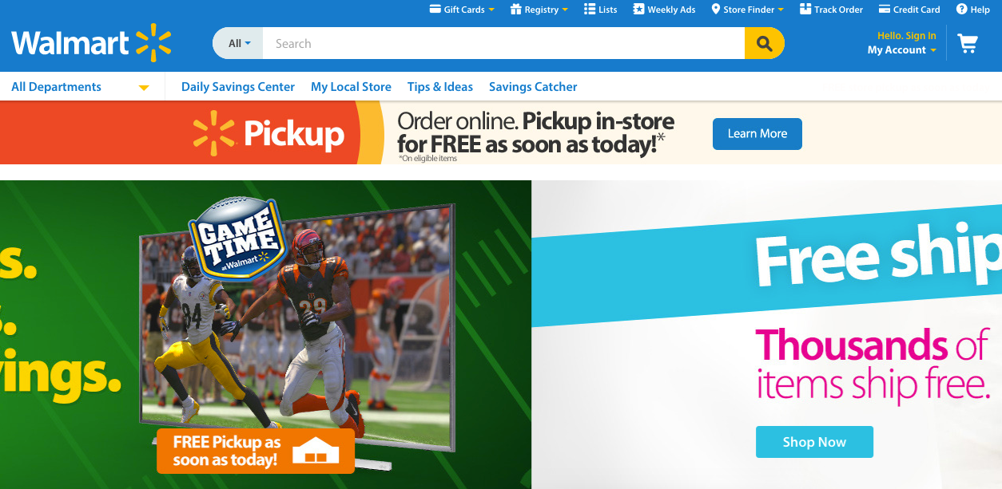
Showcase
Twitter Bootstrap
Zurb Foundation

Slide 30
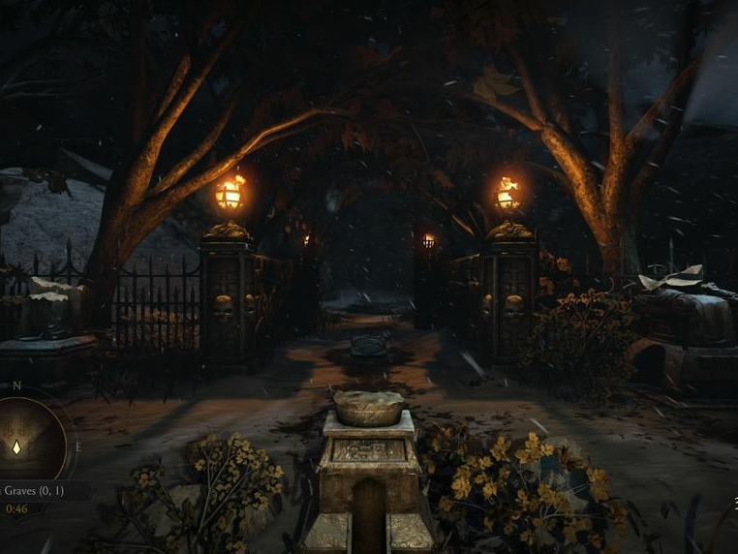
Questions?

